Slide 1
Attention-Driven Deep Feature Boosting for Skin Cancer Classification
BATCH - 11
22071A6693 – K.M. Shirisha Deva
22071A66B6 – P. Himesh
22071A66C2 – S. Lasya
22071A66C5 – V. Srivardhan
Dr. K Archana
Assistant Professor
Dept of CSE AIML & IOT
VNR VJIET

Slide 2
ABSTRACT
Skin cancer remains a major global health challenge, where early detection significantly improves survival rates but manual diagnosis is subjective and error-prone. Traditional machine learning approaches, though accurate in controlled settings, rely on handcrafted features and fail to generalize across diverse dermoscopic datasets. Recent advances in deep learning — particularly CNNs enhanced with attention mechanisms — have achieved state-of-the-art accuracy by focusing on critical lesion regions and multi-scale features. Lightweight attention-driven models (e.g., Attention-Driven CNNs, Eff2Net) enable efficient deployment on resource-limited devices while retaining high diagnostic accuracy. However, a gap remains in integrating attention-based CNNs with robust classifiers (like Gradient Boosting) to balance efficiency, interpretability, and diagnostic performance — forming the basis of our proposed approach.

Slide 3
INTRODUCTION
Skin cancer is one of the most common cancers worldwide, and early detection is crucial for improving survival rates. Manual diagnosis using dermoscopy is time-consuming, subjective, and prone to inter-observer variability, which creates a strong need for automated, reliable diagnostic systems. While traditional machine learning approaches provided some success, they were limited by reliance on handcrafted features and lack of scalability. Advances in deep learning, particularly convolutional neural networks (CNNs), have significantly improved performance through automated feature extraction. More recently, attention mechanisms and hybrid architectures have shown further improvements in accuracy, efficiency, and interpretability. However, challenges remain in developing models that are both robust and lightweight, while maintaining clinical reliability.

Slide 4
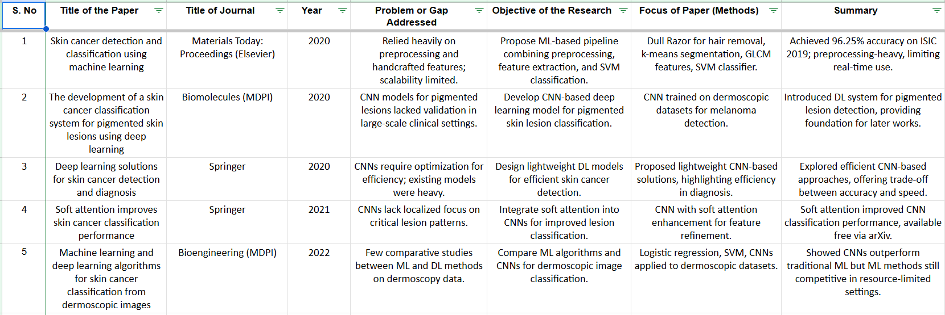
REVIEW PAPER FINDINGS

Slide 5
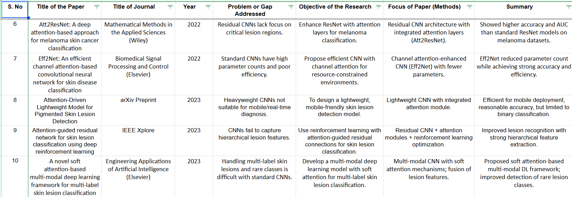

Slide 6
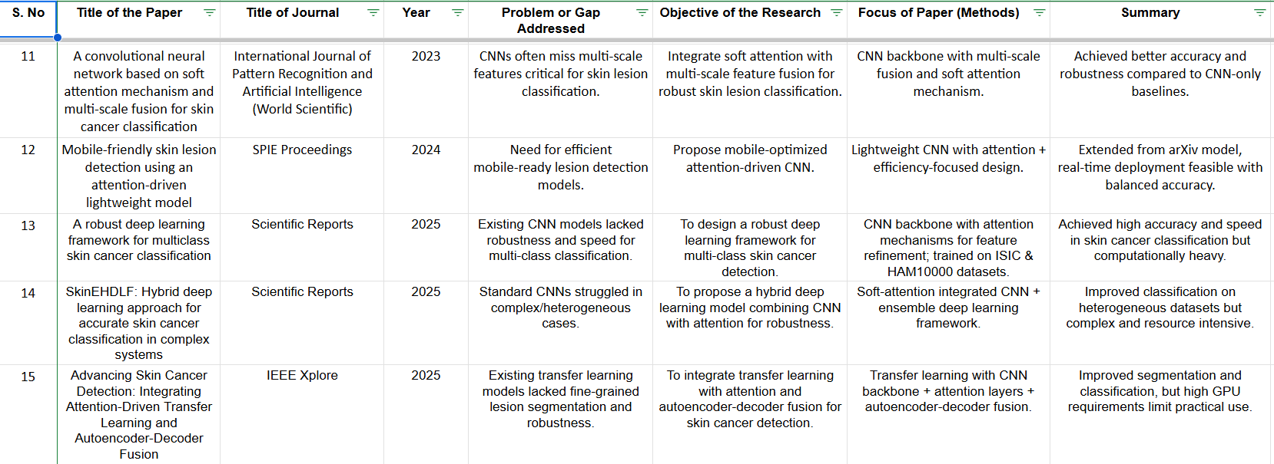

Slide 7
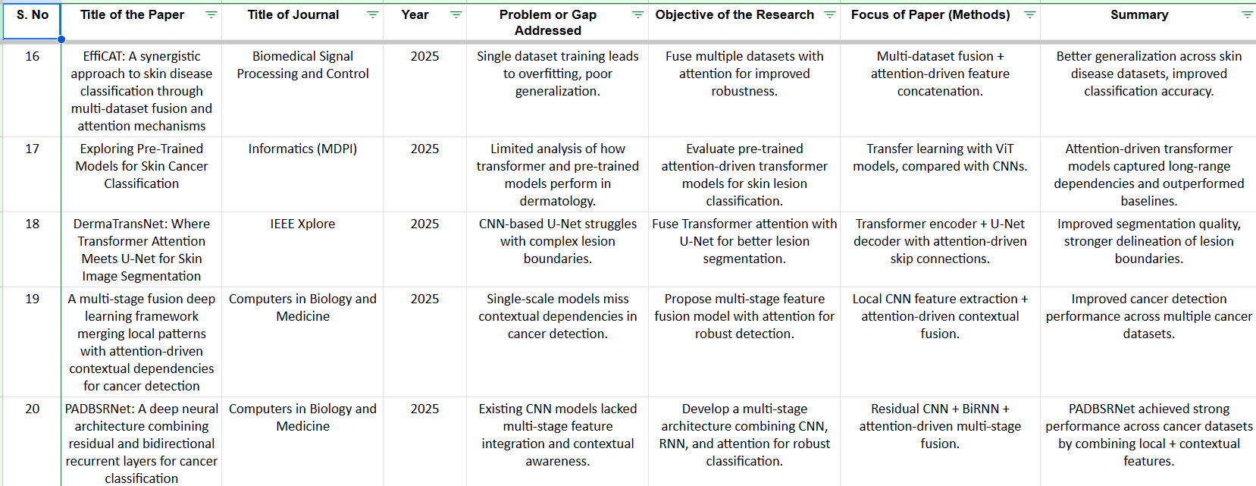

Slide 8
LITERATURE REVIEW CONCLUSION
Performance Evolution
Accuracy improved from ~85% in early CNN models (2020) to >93% in recent attention-based and hybrid frameworks.
Attention modules and fusion strategies consistently outperformed plain CNNs.
Architecture Trends
Hybrid CNN-Attention models and multi-scale fusion approaches improved robustness and generalization.
Transformer-based methods showed strong results for global context but required more data and computation.
Explainability
Attention mechanisms and visualization tools (e.g., Grad-CAM) enhanced interpretability, making results more clinically relevant.
Clinical Readiness
Several models now achieve radiologist-level accuracy in controlled settings.
Lightweight attention-driven CNNs show potential for real-time and mobile deployment.

Slide 9
PROBLEM DEFINITION
Skin cancer diagnosis requires early and accurate detection, as it directly impacts patient outcomes.
Traditional methods are manual, subjective, and depend on dermatologist expertise → causing inconsistencies and delays.
Conventional machine learning models rely on handcrafted features and fail to generalize across diverse dermoscopic datasets.
Deep learning models (CNNs) improve accuracy but face challenges in:
Handling multi-class classification
Maintaining computational efficiency
Providing interpretability
Attention mechanisms improve feature refinement, but most models are:
Computationally heavy
Dataset-specific
Lacking integration with robust classifiers
There is a need for a lightweight, attention-driven deep learning framework combined with robust classifiers for accurate, efficient, and clinically reliable skin cancer classification.

Slide 10
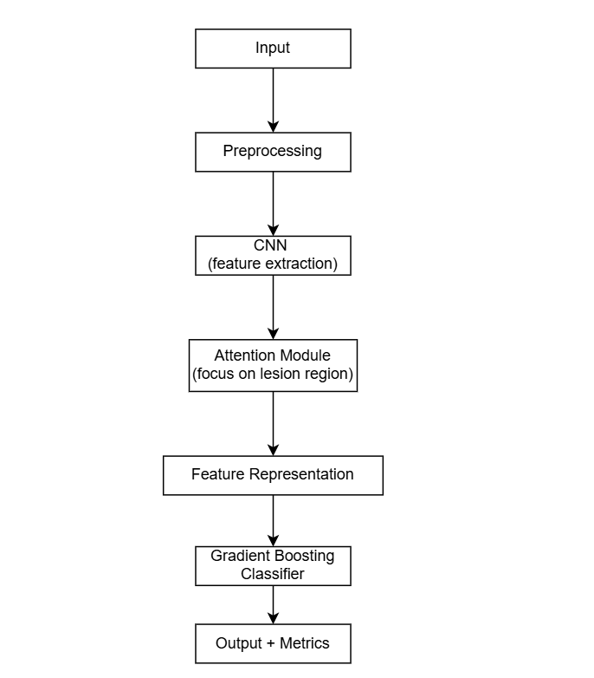
PROPOSED SYSTEM

Slide 11
PLAN OF ACTION
5. Month 9: Gradient Boosting Classifier Integration
Replace softmax with boosting (XGBoost/LightGBM)
Compare with CNN-only models
6. Month 10: Evaluation & Optimization
Test across multiple datasets
Hyperparameter tunin
7. Month 11 & 12:
Apply Grad-CAM / XAI methods
Validate results against clinical reasoning
Prepare final report, PPT, and paper draft
Submission and presentation
Month 1–2: Literature Review & Problem Definition
Collect and analyze 20+ papers
Finalize problem statement & objectives
Month 3–4: Dataset Collection & Preprocessing
Acquire ISIC / HAM10000 datasets
Perform cleaning, augmentation, normalization
Month 5–6: Baseline Model Implementation
Implement CNN baseline
Evaluate on benchmark metrics
Month 7–8: Attention Module Integration
Add soft/channel attention to CNN
Analyze improvements in performance

Slide 12
THANK YOU

